Slide 1
Today’s Agenda
        Part one
                Welcome and Introductions
        Part two
                Dude Nation
        Part three
                West Virginia Involvement
        Part four
                CEFP Project
        part five
                Capital Forecast Overview
        part Six
                Dude Solutions 360 Overview
        part SEVEN
                Q&A and Closing

Slide 2
Dude Solutions: Driving Enterprise Value
80s—90s
2000
SaaS-Driven Efficiencies
2016
Data-Driven Insights
2030
Manual
Paper
On-Prem
The Dude introduces insights for Next Generation M&O
Enterprise Value Creation
The Dude moves M&O to the Cloud

Slide 3
Dude Solutions: Enterprise Platform Foundations
2.8M Users
11,750 Clients
28M Students
#1 in SaaS Enterprise Asset Management
Largest operations data warehouse in the industry
Cloud/
SaaS
Data
250M Work Orders
12M+ Assets
$9B Asset Value
Internet of People (IoP)
986,000
Buildings
$3B Energy Tracked
Most extensive ecosystem of people and related requests
97% Client Satisfaction

Slide 4
SOFTWARE TO SOLVE EVERY CHALLENGE THAT COMES YOUR WAY
      EDUCATION
WORK & ASSET
management
EVENT
management
ENERGY
management
TECHNOLOGY
management
WORK & ASSET™
FACILITY
SCHEDULING™
ENERGY Accounting™
Help Desk™
CAPITAL
FORECASTING™
Community Use™
Utility Bill Population™
IT ASSET
DISCOVERY™
PUBLISHING™
Interval data recording™
MDM™
TRIP
PLANNING™

Slide 5
Dude Solutions in WV

Slide 6
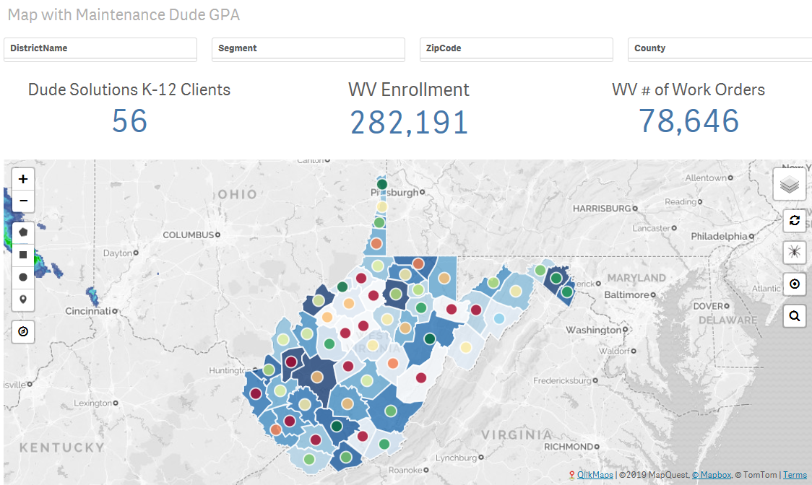
Dude Solutions - WV
Preventive Maintenance Direct
State Wide PM Program
Utilizing PM Templates for each account
55 Counties participating

Slide 7
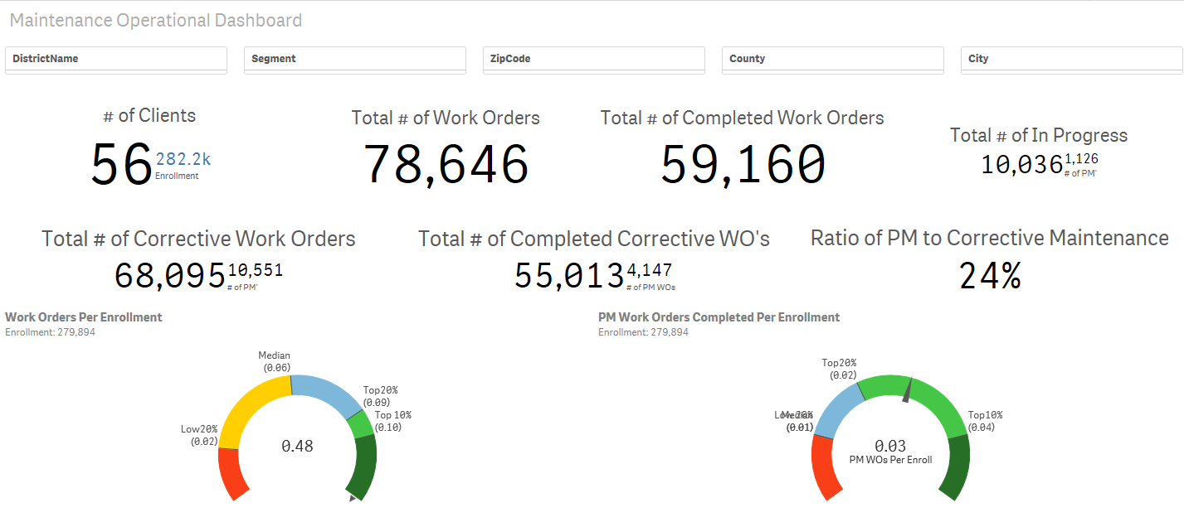
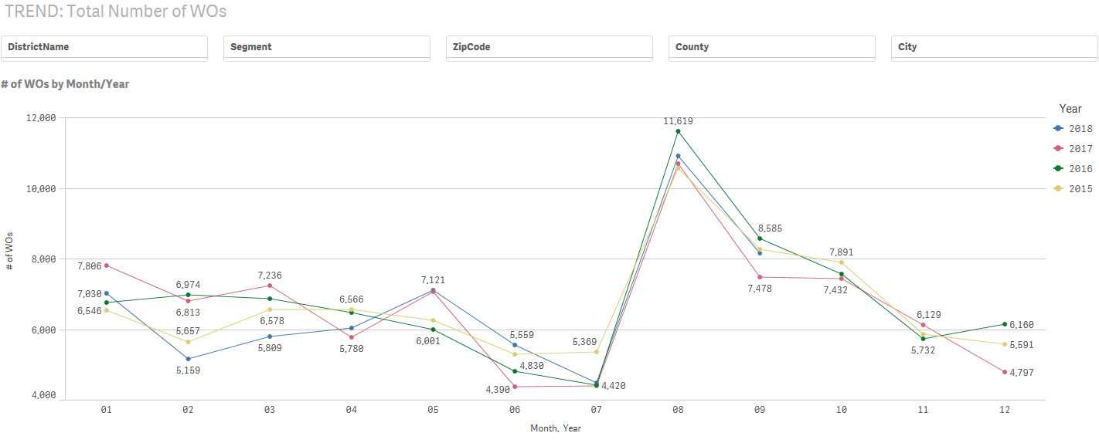
Dude Solutions - WV
Preventive Maintenance Direct
Data Analysis
KPI’s

Slide 8
CEFP Project
Process
(Phase 1)

Slide 9
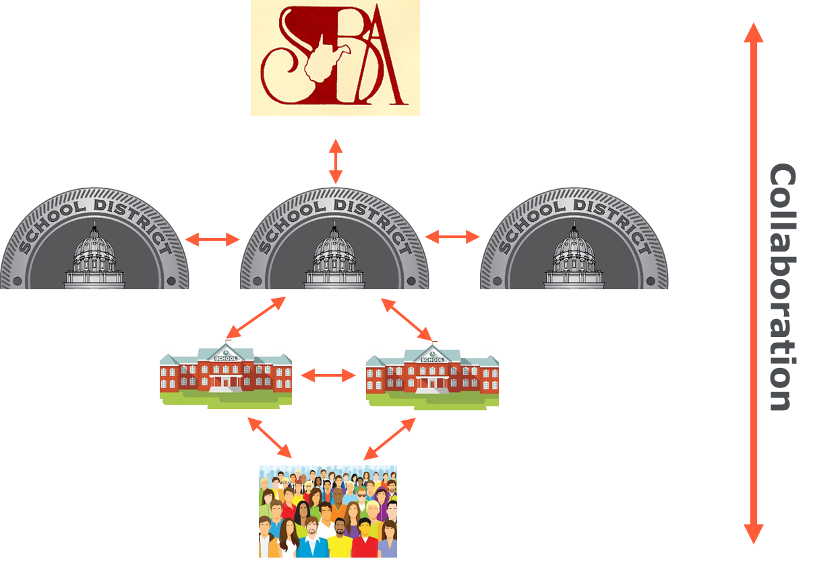
Dude Solutions 360 – The CEFP Engagement Platform
  Marketing Platform
  Engagement Platform

Slide 10
Dude Solutions 360 Platform
Dude 360
DS Power Apps
Cloud Data Aggregator
Forms Based Data Repository
Business Intelligence
User Management
Role Based Security
Social Community
File Share/Management
Document Management
Knowledge Management
Process Documentation
Resource Library
API Connectivity
Responsive
CapitalForecastDirect
MaintenanceDirect
PMDirect

Slide 11
Contracted Services
Alpha Facility Solutions
  Nationwide provider of capital planning, FCA and maintenance management services
  The FCA is just one component of the total CEFP project
  Responsibilities: A/E Data Collection Tool, A/E training and FCA oversight, import and data validation, Facility Condition Reports
Dude Solutions
  SaaS Software provider
  Responsibilities: Implement CapitalForecastDirect at each county. Configure and Implement Dude Solutions 360 to manage the CEFP process.

Slide 12
Phase 1 Processes
Alpha Facility Solutions
SBA will notify Alpha of A/E awarded contracts
Alpha will send A/E welcome email with unique credentials to access the Alpha FTP Site https://webftp.alphafacilities.com to download the latest version of the Data Collection Tool, instructions and training materials.
A/E will download Data Collection tool on appropriate device to conduct FCA
A/E will coordinate with the schools regarding schedule and process for completing the FCA and CEFP data gathering
Once data is gathered and validated, A/E will upload to the Alpha FTP Site
Alpha will use the data to prepare Facility Condition Report for the A/E firm to review and concur. Alpha will provide the report to the County.

Slide 13
Phase 1 Processes
Dude Solutions
Alpha will import school FCA data into the County CapitalForecastDirect (CFD) accounts. Alpha & Dude Solutions will validate the data.
After the county CFD account is populated, Dude Solutions will schedule individual virtual webinar training with appropriate county contact to review their CFD Account.
A/E Firm Facility Condition Assessments
A/E Firms to conduct FCA using data collection tool for each School
Data Import & Validation
Data will be imported into each CFD County Account
CFD Training
Individual Counties will be contacted for training upon completion of data import
  3. Dude Solutions will host weekly virtual group trainings for Dude Solutions 360. (Registration, File Library, CEFP process and document management)

Slide 14
Capital Forecast
Direct

Slide 15
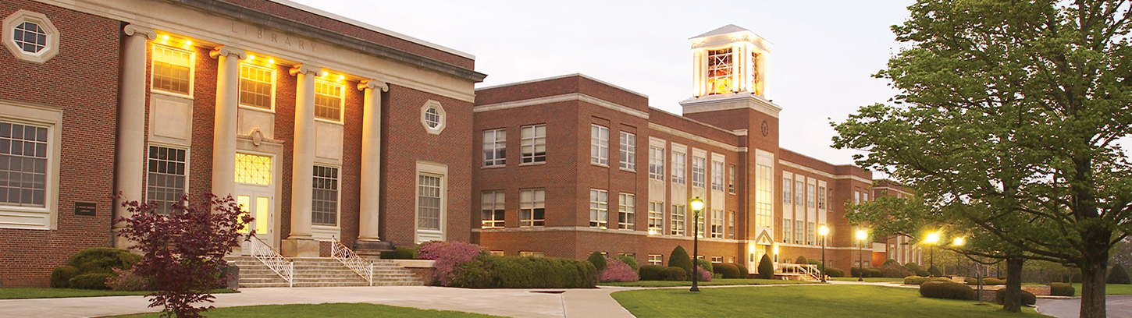
The Product – CapitalForecastDirect
CFD
What is it?
CapitalForecastDirect is a facilities forecasting tool for schools with the power to predict future projects and prioritize current ones

Slide 16
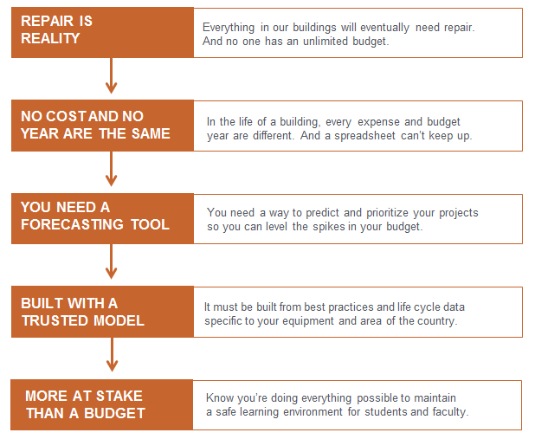
The Product – CapitalForecastDirect

Slide 17
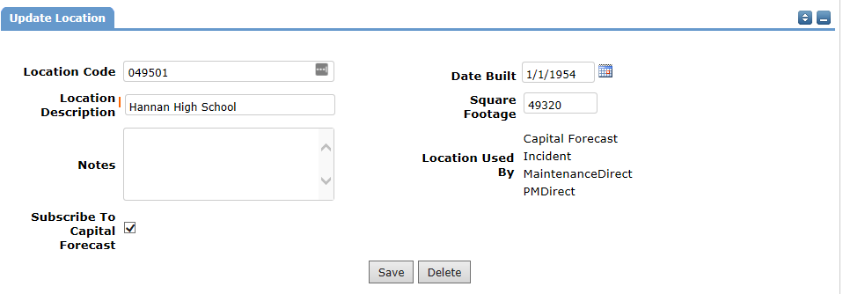
The Product – CapitalForecastDirect
Step 1
Account will be prepopulated with FCA data
Alpha Facility Solutions to perform imports

Slide 18
The Product – CapitalForecastDirect
SyStems
Account will be prepopulated with major Systems
Foundation Basement Construction Superstructure - Floor & Roof Construction Exterior Enclosure - Exterior Walls (Framing) Exterior Enclosure - Exterior Walls (Finishes) Exterior Enclosure - Exterior Windows Exterior Enclosure - Exterior Doors Roofing Interior Construction - Partitions & Stairs Interior Construction - Interior Doors Interior Construction - Specialties Interior Finishes - Wall Finishes Interior Finishes - Floor Finishes Interior Finishes - Ceiling Finishes Conveying Systems Plumbing - Plumbing Fixtures Plumbing - Domestic Water Distribution | Plumbing - Sanitary Waste Plumbing - Rain Water Drainage HVAC - Energy Supply HVAC - Heat Generating Systems HVAC - Cooling Generating Systems HVAC - Distribution System HVAC - Terminal & Package Units HVAC - Controls & Instrumentation Fire Protection - Sprinklers & Standpipe Fire Protection - Fire Alarm & Detection Electrical - Service & Distribution Electrical - Branch Wiring Electrical - Lighting Electrical - Other Electrical Services Equip & Furnishings - Commercial Equipment Equip & Furnishings - Institutional Equipment Equip & Furnishings - Vehicular Equipment Equip & Furnishings - Other Equipment

Slide 19
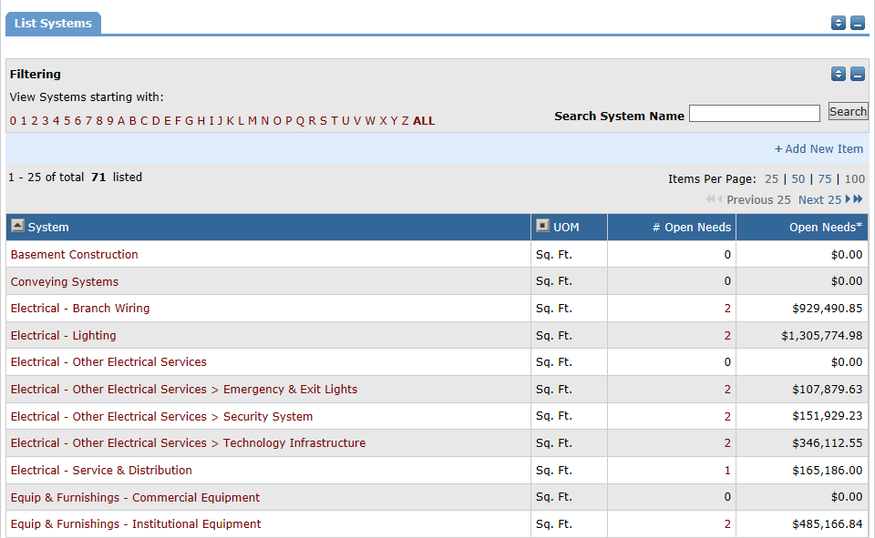
The Product – CapitalForecastDirect
List of Systems in Account

Slide 20
The Product – CapitalForecastDirect
Building Types
Extensive list of Building Types
CFD Building Types
Administration Office Apartment Athletic Center Auditorium Bank Barn Bowling Alley Cafeteria Call Center Car Wash Church Classroom Community Center Convenience Store/Service Station Country Club Data Center Day Care Center Department Store Distribution Center Dormitory | Dry Cleaning/Laundry Elementary School Fire Station Greenhouse Guard House Health Clinic/Outpatient Surgery Center High School Hospital Hotel Laboratory, Agriculture Laboratory, Biology Laboratory, Electronics Laboratory, General Library Maintenance Shop Manufacturing Plant Motel Motor Vehicle Service Museum Natatorium | Parking Garage Passenger Terminal Post Office Pre-Manufactured Building Preschool Public Restroom Restaurant, Fast Food Restaurant, Full-menu Retail Store Single Family House Skating Rink Storage Shed Student Union Supermarket Warehouse, Hazardous Materials Warehouse, Non-Temperature Controlled Warehouse, Temperature Controlled

Slide 21
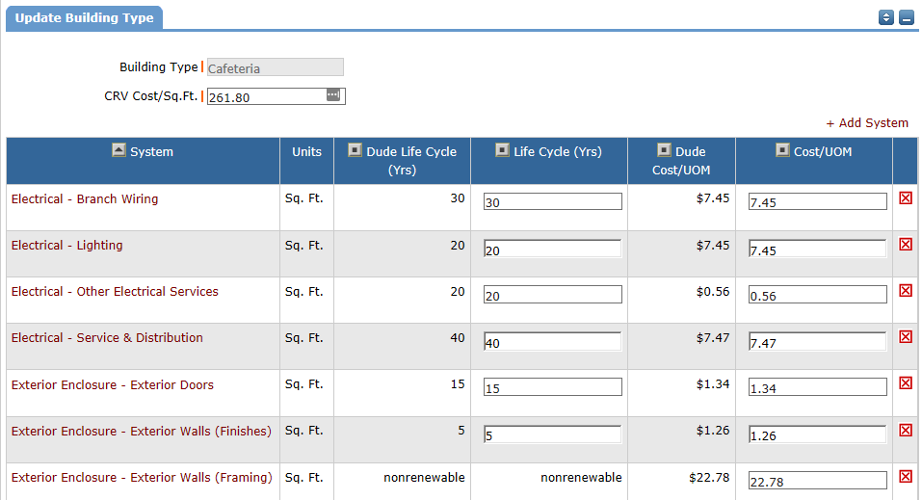
The Product – CapitalForecastDirect
Building Types

Slide 22
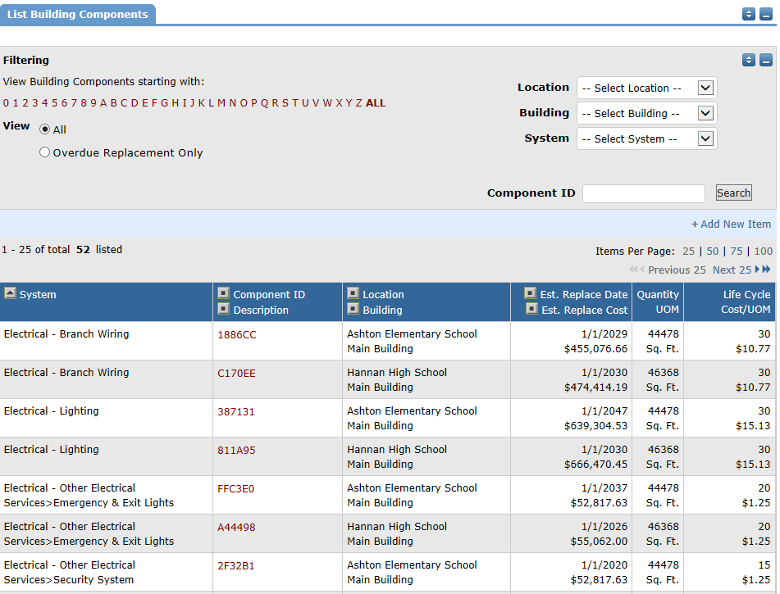
The Product – CapitalForecastDirect
Building Components
Building components with Assessment data will be imported from FCA

Slide 23
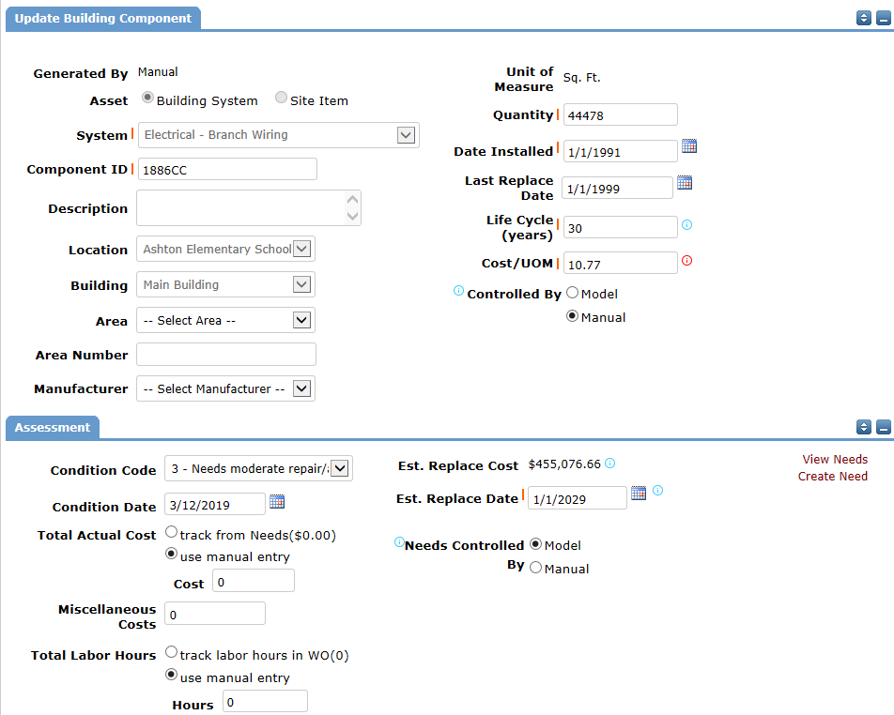
The Product – CapitalForecastDirect
Building Component – In detail

Slide 24
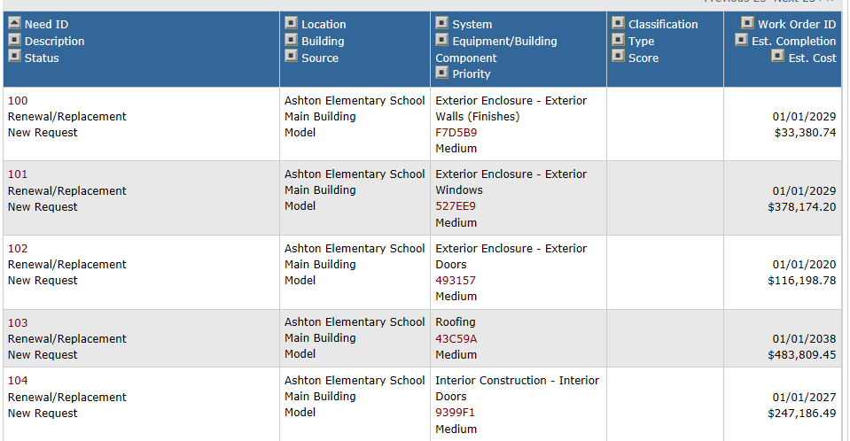
The Product – CapitalForecastDirect
Needs/Plan Length
Model will Generate Needs for the Next 30 years
You can determine how you want your needs generated
You can turn on/off Model generated Needs per building component
You can manually generate Needs for any building component

Slide 25
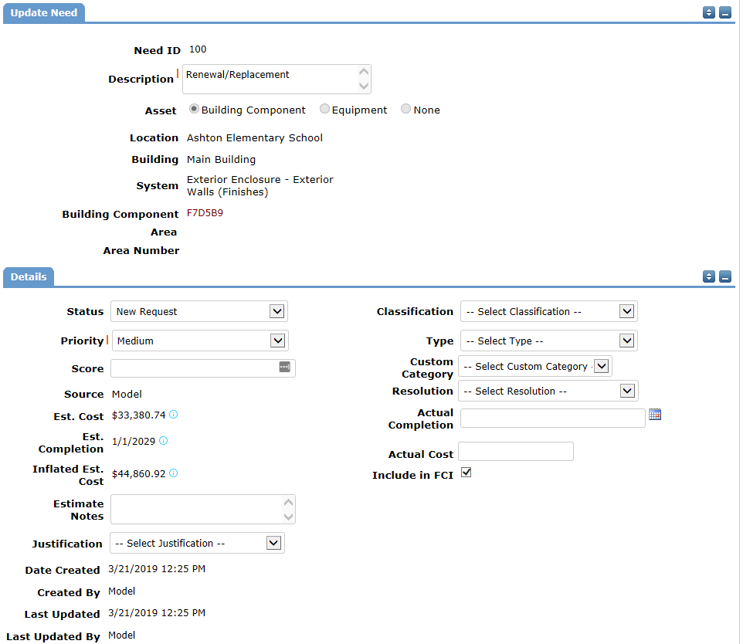
The Product – CapitalForecastDirect
Need in Detail

Slide 26
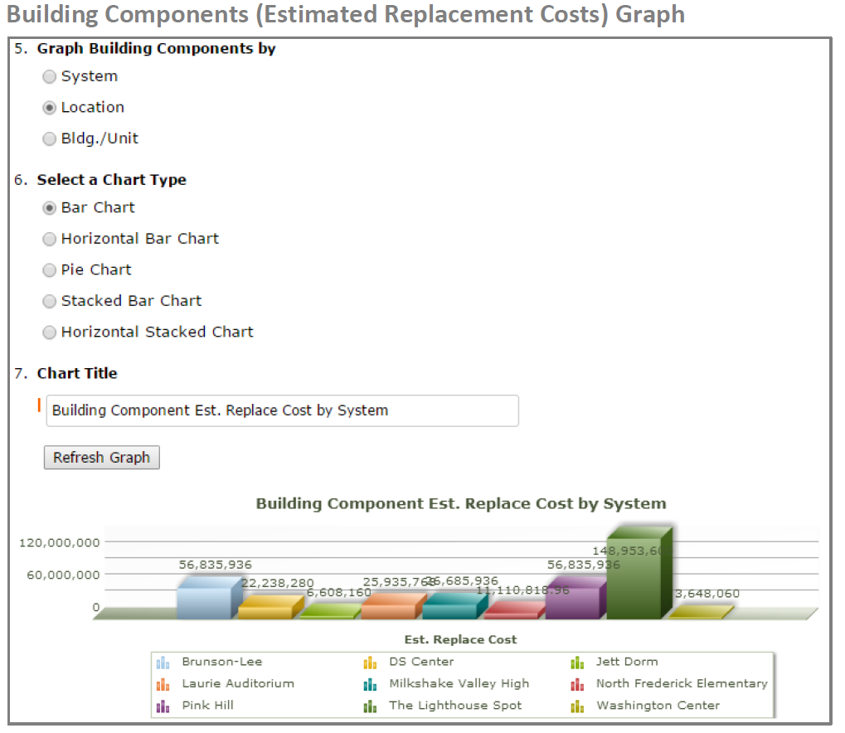
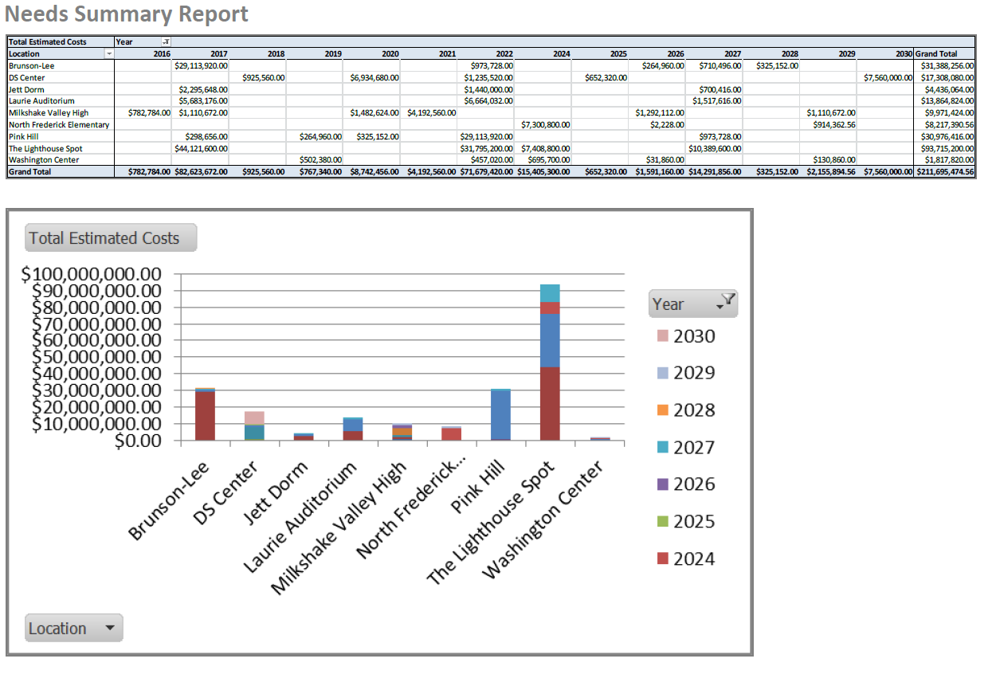
The Product – CapitalForecastDirect
Reports

Slide 27
Dude Solutions 360

Slide 28
The Product – Dude Solutions 360
360
What is it?
An enterprise solution empowering districts to capture and create a 360 degree view of their data from multiple sources – including facility health, asset efficiency, energy utilization, events management and capital spending – and leverage actionable insights to drive informed decision-making.

Slide 29

where is the value?
1
One stop shop
Centralize information from multiple sources to build a story and save time
4
drive Continuous improvement
Identify what you are doing well and what areas need focus then take action
2
Make informed decisions
better data = better decisions
5
Stay connected
Gather feedback from your community and provide vital info back to them to create a place of dialogue
3
KNOW WHERE YOU STAND
See what’s going on in your organization and how you stack up to your peers
6
Streamline processes
Automate tasks to create a seamless experience

